Slide 1
Switch Statement & Functions
Md. Alamgir Hossain
Senior Lecturer,
Dept. of CSE, Prime University
Mail: alamgir.cse14.just@gmail.com

Slide 2

Switch Statement in C
Switch case statement evaluates a given expression and based on the evaluated value(matching a certain condition), it executes the statements associated with it.
Basically, it is used to perform different actions based on different conditions(cases).
They are a substitute for long if statements that compare a variable to several integral values.
The switch statement is a multiway branch statement. It provides an easy way to dispatch execution to different parts of code based on the value of the expression.

Slide 3
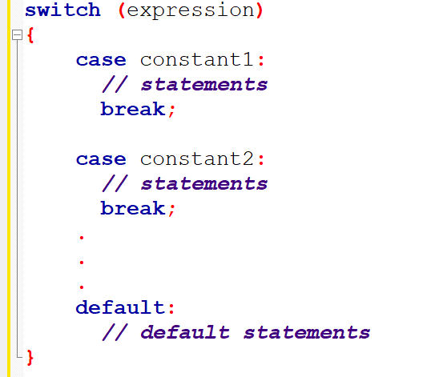
Syntax of Switch….Case

Slide 4
Rules of the Switch Case Statement
In a switch statement, the “case value” must be of “char” and “int” type.
There can be one or N number of cases.
The values in the case must be unique.
Each statement of the case can have a break statement. It is optional.
The default Statement is also optional.

Slide 5
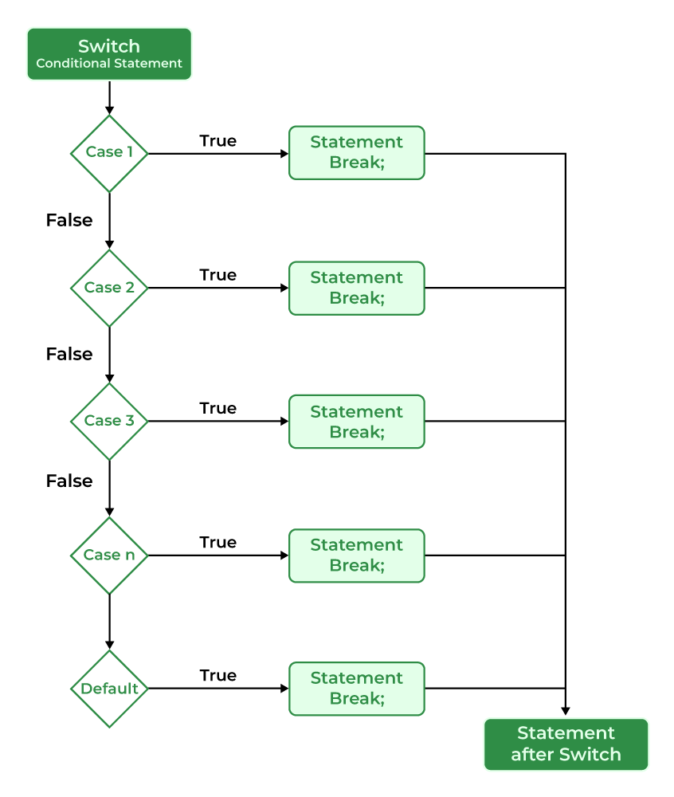
Flowchart of Switch Case Statement

Slide 6
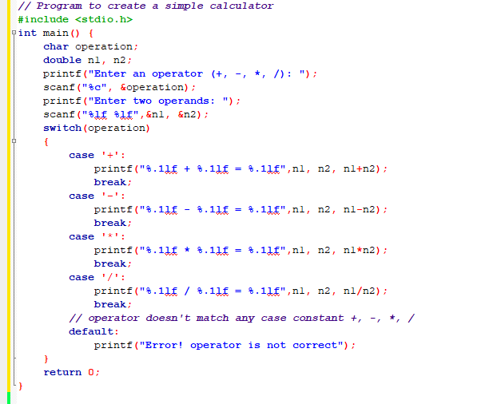

Slide 7
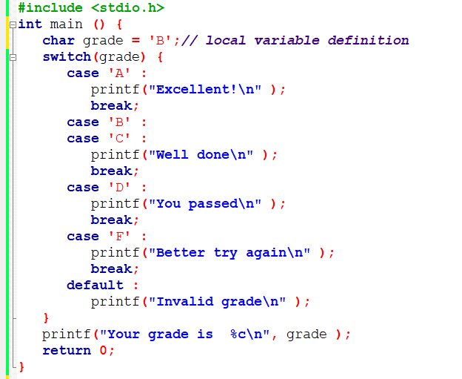

Slide 8
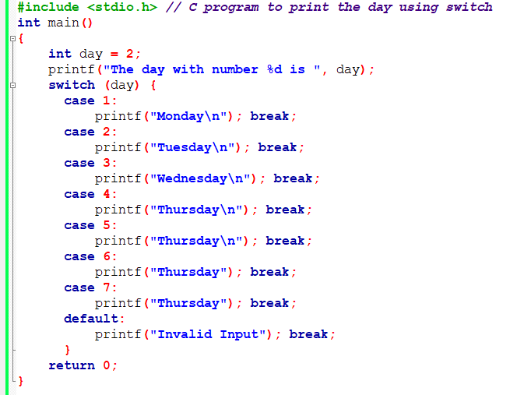

Slide 9
Differences between Switch and if else if ladder
switch statement | if-else-if ladder statement
The expression used in switch statement can return an integer or character. | The expression used in if-else-if ladder statement returns true or false value.
switch statement has more flexibility. | if-else-if ladder statement have poor flexibility.
This statement is easy to handle. | This statement is difficult to handle.
In switch statement each case of switch the last statement must be the break statement. | In if-else-if ladder statement there is no necessity of break statement.
There is no need to put the multiple statements of a case into braces. | Multiple statements of if-else-if ladder statement must be within braces.
switch statement have clearer format than if-else-if ladder statement. | if-else-if ladder statement have a complex format.
In switch statement the keyword switch, case and default are used. | In if-else-if ladder statement the keyword if and else are used.

Slide 10
Differences between Switch and if else if ladder
Write a C program to find all roots of a quadratic equation using switch case.

Slide 11

Functions
A function is a block of code that performs a specific task.
Suppose, you need to create a program to create a circle and color it. You can create two functions to solve this problem:
create a circle function
create a color function
There are two types of function in C programming:
Standard library functions
User-defined functions

Slide 12
Standard Library Functions
The printf() is a standard library function to send formatted output to the screen (display output on the screen). This function is defined in the stdio.h header file.
The sqrt() function calculates the square root of a number. The function is defined in the math.h header file.
Others are gets(), puts(), ceil(), floor() etc.

Slide 13
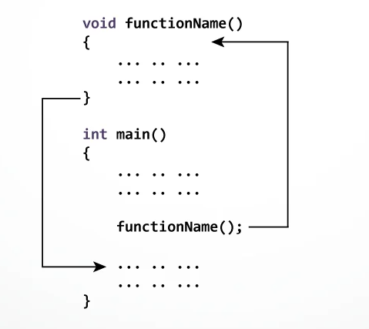
User-defined Function
We can also create functions as per your need. Such functions created by the user are known as user-defined functions.
Working with User-defined Function---

Slide 14
Different Aspects of Function Calling
function without arguments and without return value.
function without arguments and with return value.
function with arguments and without return value.
function with arguments and with return value.

Slide 15
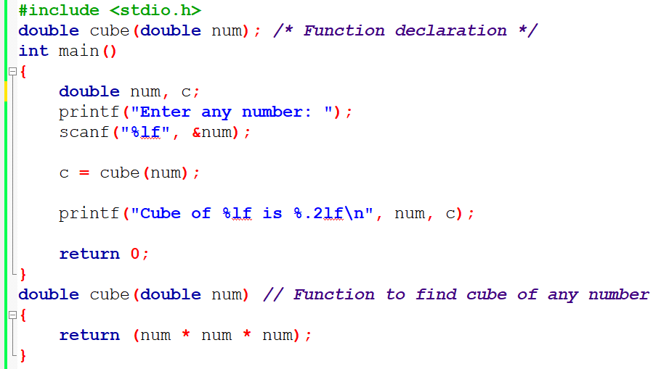
Program to Find Cube of a Number

Slide 16
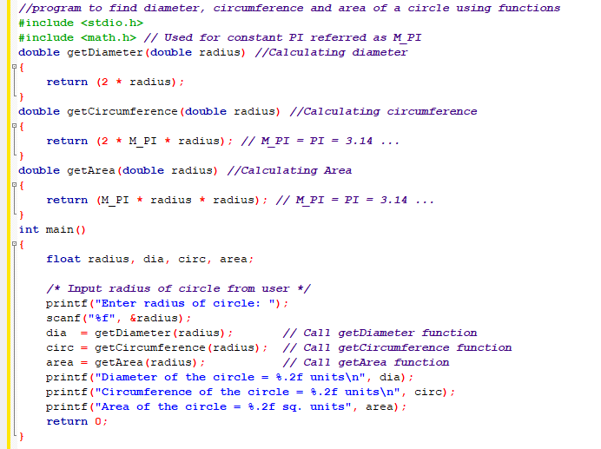

Slide 17
Call by Value
There are two methods to pass the data into the function in C language, i.e., call by value and call by reference.
In call by value method, the value of the actual parameters is copied into the formal parameters. In other words, we can say that the value of the variable is used in the function call in the call by value method.
In call by value method, we can not modify the value of the actual parameter by the formal parameter.
In call by value, different memory is allocated for actual and formal parameters since the value of the actual parameter is copied into the formal parameter.
The actual parameter is the argument which is used in the function call whereas formal parameter is the argument which is used in the function definition.

Slide 18
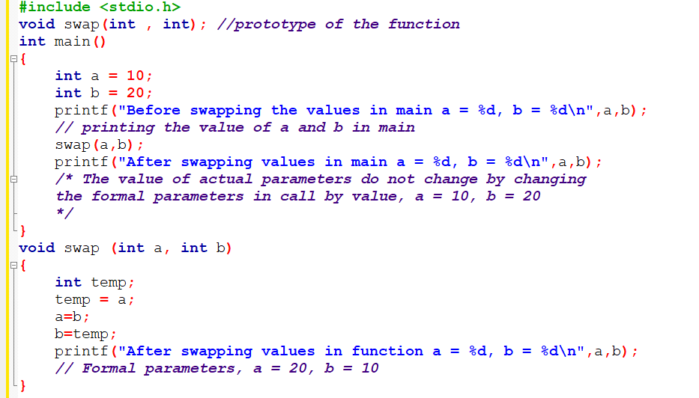
Example of Call by Value

Slide 19
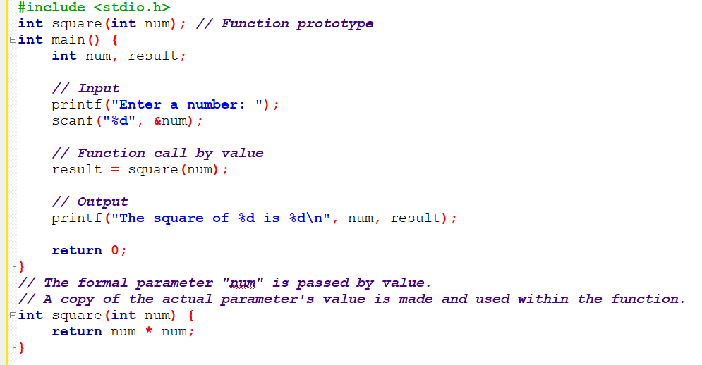
Another Example of Call by Value

Slide 20
Call by Reference
In call by reference, the address of the variable is passed into the function call as the actual parameter.
The value of the actual parameters can be modified by changing the formal parameters since the address of the actual parameters is passed.
In call by reference, the memory allocation is similar for both formal parameters and actual parameters. All the operations in the function are performed on the value stored at the address of the actual parameters, and the modified value gets stored at the same address.

Slide 21
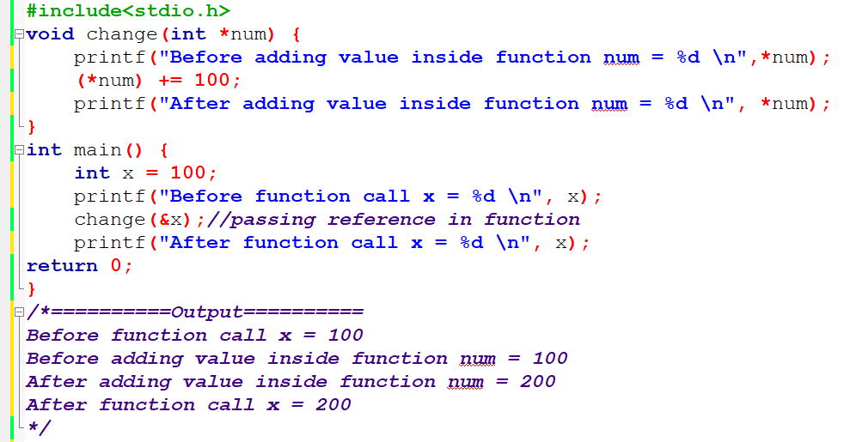
Example of Call by Reference

Slide 22
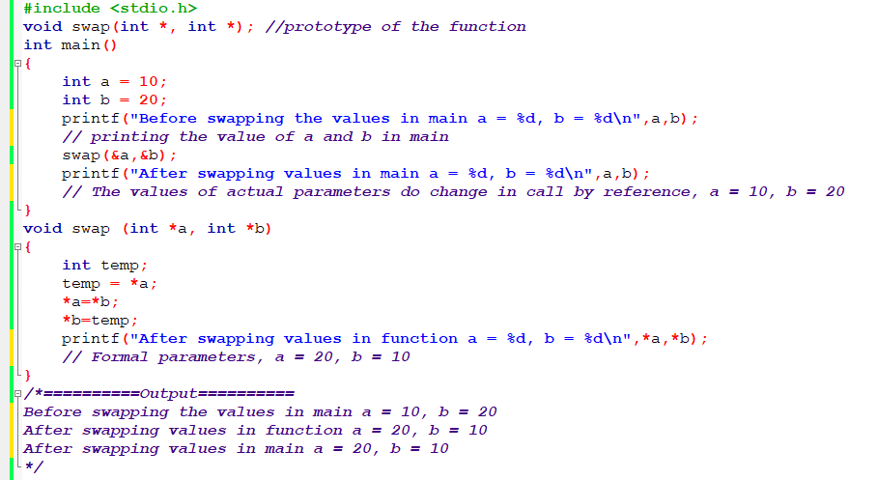
Call by reference Example: Swapping the values of the two variables

Slide 23
Difference between call by value and call by reference in c
Call by value | Call by reference
A copy of the value is passed into the function | An address of value is passed into the function
Changes made inside the function is limited to the function only. The values of the actual parameters do not change by changing the formal parameters. | Changes made inside the function validate outside of the function also. The values of the actual parameters do change by changing the formal parameters.
Actual and formal arguments are created at the different memory location | Actual and formal arguments are created at the same memory location

Slide 24
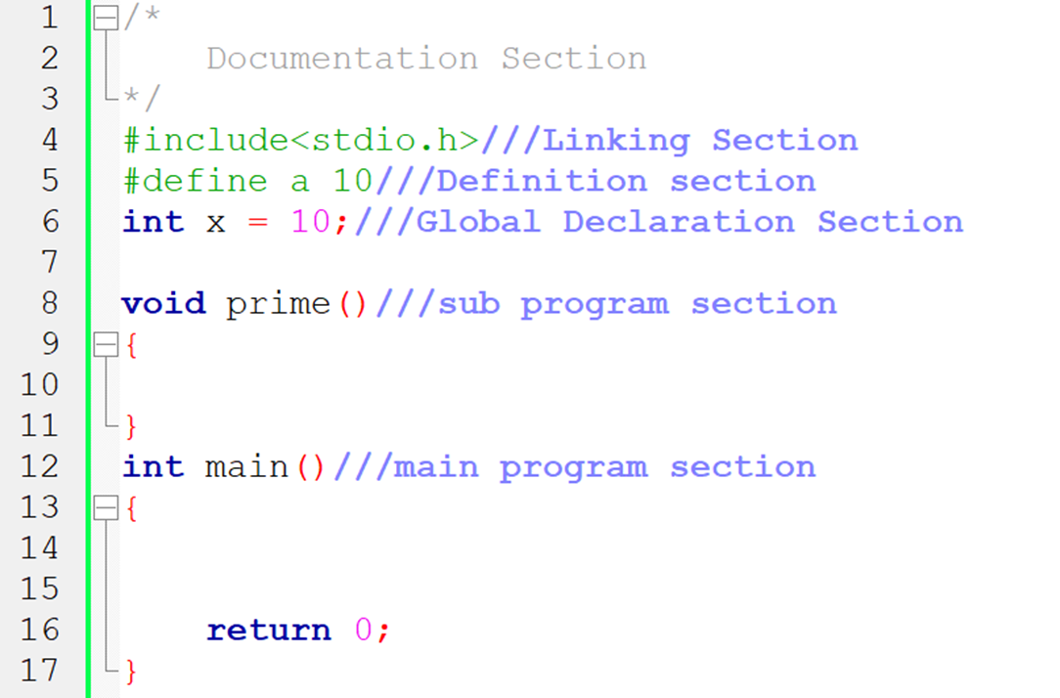
Major Parts of a C Program

Slide 25
Homework
Write a C program to calculates the sum and average of three numbers using a functions with call by reference.

Slide 26
Thank You

